Slide 1


HEALTH MONITORING USING MACHINE LEARNING
Team Members:
Babu Aman Singh
Rahul M Dinesh
Shivanand G Prabhu

Slide 2

INTRODUCTION:
Health Monitoring Systems continue to evolve in this digital age.
The Health Monitoring Systems access the patient’s historical data to provide insights on patient diagnosis in real-time.
Patients need an intensive care from medical staff and they have to be always monitored using monitoring systems.
As a result, monitoring systems is considered as a fundamental tools. It uses monitoring devices to measure several medical parameters that indicate the state of patients.

Slide 3
SKILLS REQUIRED:
Our aim for the project is to make use of pandas, matplotlib & seaborn libraries from python to extract the libraries for machine learning for health monitoring.
Secondly, to learn how to hyper-tune the parameters using grid across validation for the random forest machine learning algorithm.
And in the end, to predict whether the person is healthy or not using ensembles techniques of combining the predictions from multiple machine learning algorithms and withdrawing the conclusions.

Slide 4
PURPOSE:
This system which is specifically developed to predict health status of the user.
It provides digital information of the patients which is centrally stored.
The main objective of Health Monitoring system is to predict whether a person is healthy or not.

Slide 5
DESIGN MODEL:
Machine learning(Random Forest):
Random Forest is a popular machine learning algorithm that belongs to the supervised learning technique. It can be used for both Classification and Regression problems in ML. It is based on the concept of ensemble learning, which is a process of combining multiple classifiers to solve a complex problem and to improve the performance of the model.
As the name suggests , Random Forest is a classifier that contains a number of decision trees on various subsets of the given dataset and takes the average to improve the predictive accuracy of the dataset.”

Slide 6
BLOCK DIAGRAM:
Data Set Collection
Data Pre-processing
Checking Null Values
Train and Test split data
Splitting Data
Data Visualisation
Testing Model
Incorporate with HTML and Flask
Deployment

Slide 7
SOFTWARE DESIGNING:
Jupyter Notebook Environment
Spyder IDE
Machine Learning Algorithms
Python(Pandas, numpy, matplotlib, seaborn, sklearn)
Html
Flask

Slide 8
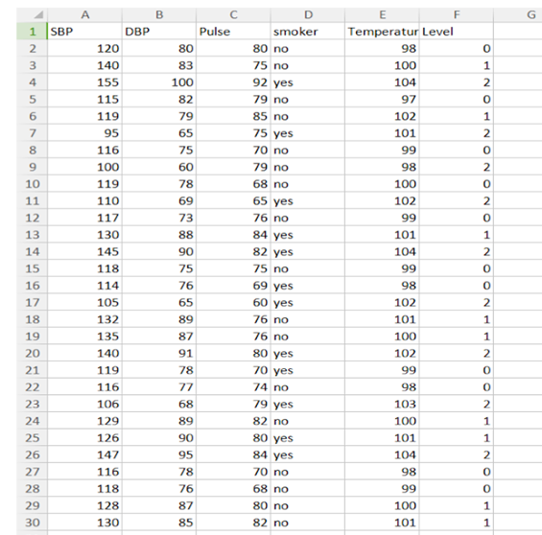
EXPERIMENTAL INVESTIGATION:
In this paper, the data set we used contains more than 100 people with 10 attributes, After that, missing values are filled and the duplicate or meaning less attributes are deleted, finally we have retained to 5 attributes .
Those attributes were shown below in the screenshot of the data set we used.

Slide 9
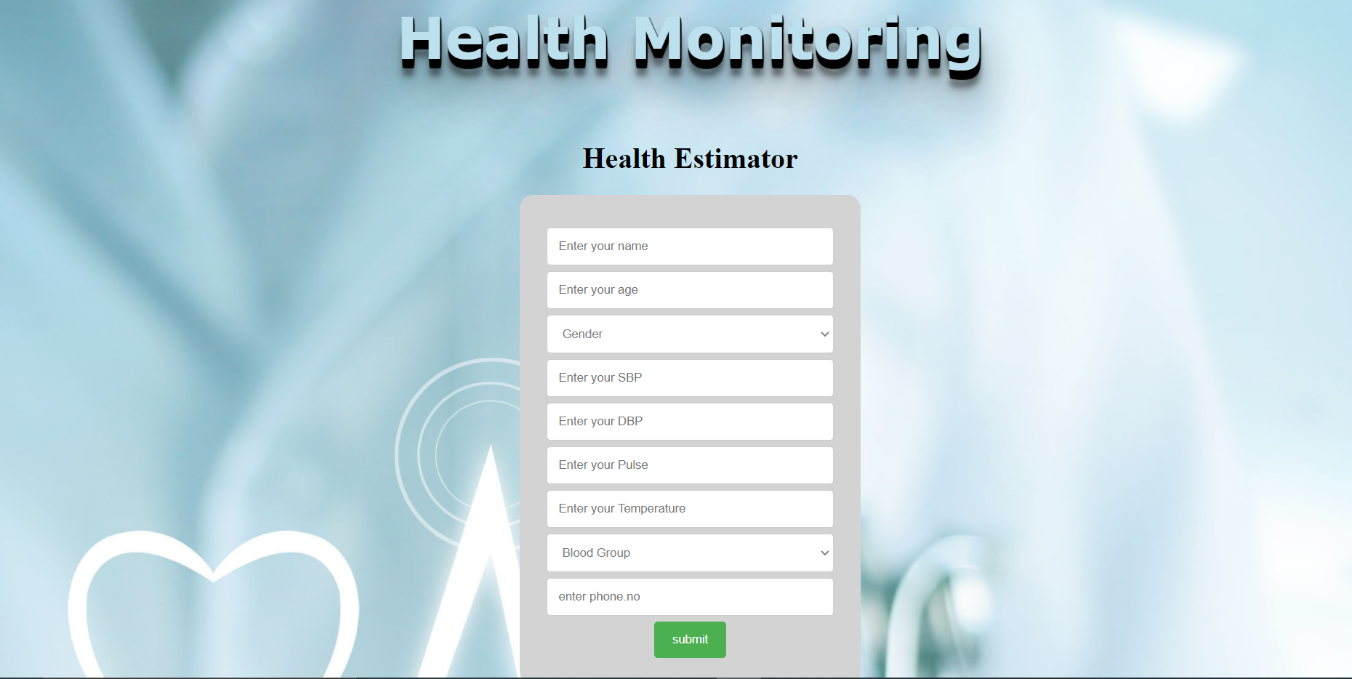
User Interface Using Flask

Slide 10
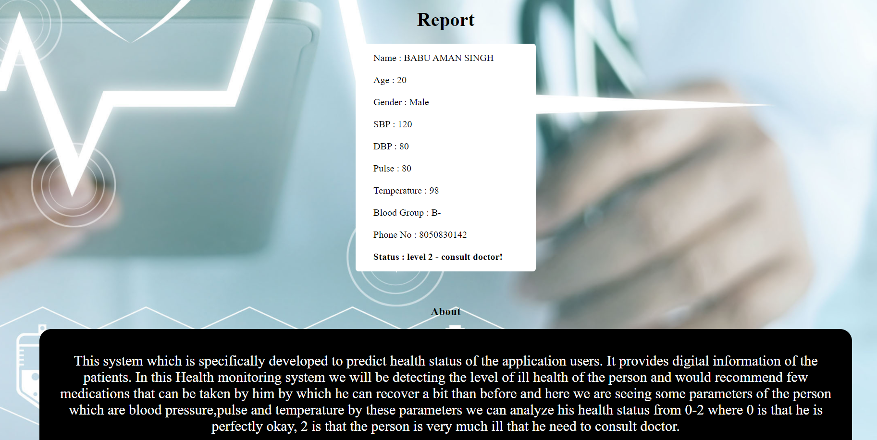

Slide 11
ADVANTAGES:
This system which is specifically developed to predict health status of the user.
tools. It uses monitoring devices to measure several medical parameters that indicate the state of patients.
Random Forests is considered as a highly accurate and robust method because of the number of decision trees participating in the process.
DISADVANTAGES:
The mode is difficult to interpret compared to a decision tree,where you can easily make a decision by following the path in the tree.

Slide 12
CONCLUSION:
In our project, the random forest algorithm is used to predict the person is healthy or not. Random Forest is a supervised learning algorithm. It can be used both for classification and regression. It also offers a good feature selection indicator.
Random forest uses gini importance or mean decrease in impurity(MDI)to calculate the importance of each feature.
This is how much the model fit or accuracy decreases when you drop a variable.The gini index can describe the overall explanatory power of the variables.
Overall, random forest is a (mostly) fast, simple and flexible tool, but not without some institutions.

Slide 13


